Slide 1
Investigation of Angles and Temperature
Year 7 Science

Slide 2

Review

Slide 3
Review
Why are the days longer in summer than winter?
Why are the days hotter in summer than winter?
Why is it hotter at the equator and in the tropics than at the poles?
Is distance from the sun the only effect on temperature?

Slide 4
Learning Intentions
Predictable phenomena on Earth, including seasons and eclipses, are caused by the relative positions of the Sun, Earth and the Moon.

Slide 5
Success criteria
Investigate how the angle of the sun affects temperature on Earth.
Explain why it is hotter in the tropics and colder at the poles.

Slide 7
https://vimeo.com/457386448

Slide 8
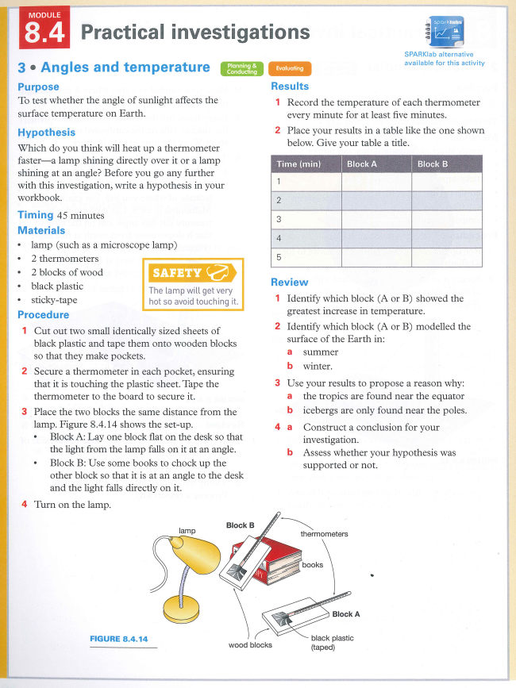
Investigation: Angles and Temperature

Slide 9
Investigation: Angles and Temperature

Slide 10
Investigation: Angles and Temperature

Slide 11
Investigation: Angles and Temperature

Slide 12
Investigation: Angles and Temperature

Slide 13
Investigation: Angles and Temperature

Slide 14
Success criteria
Investigate how the angle of the sun affects temperature on Earth.
Explain why it is hotter in the tropics and colder at the poles.

